Slide 1

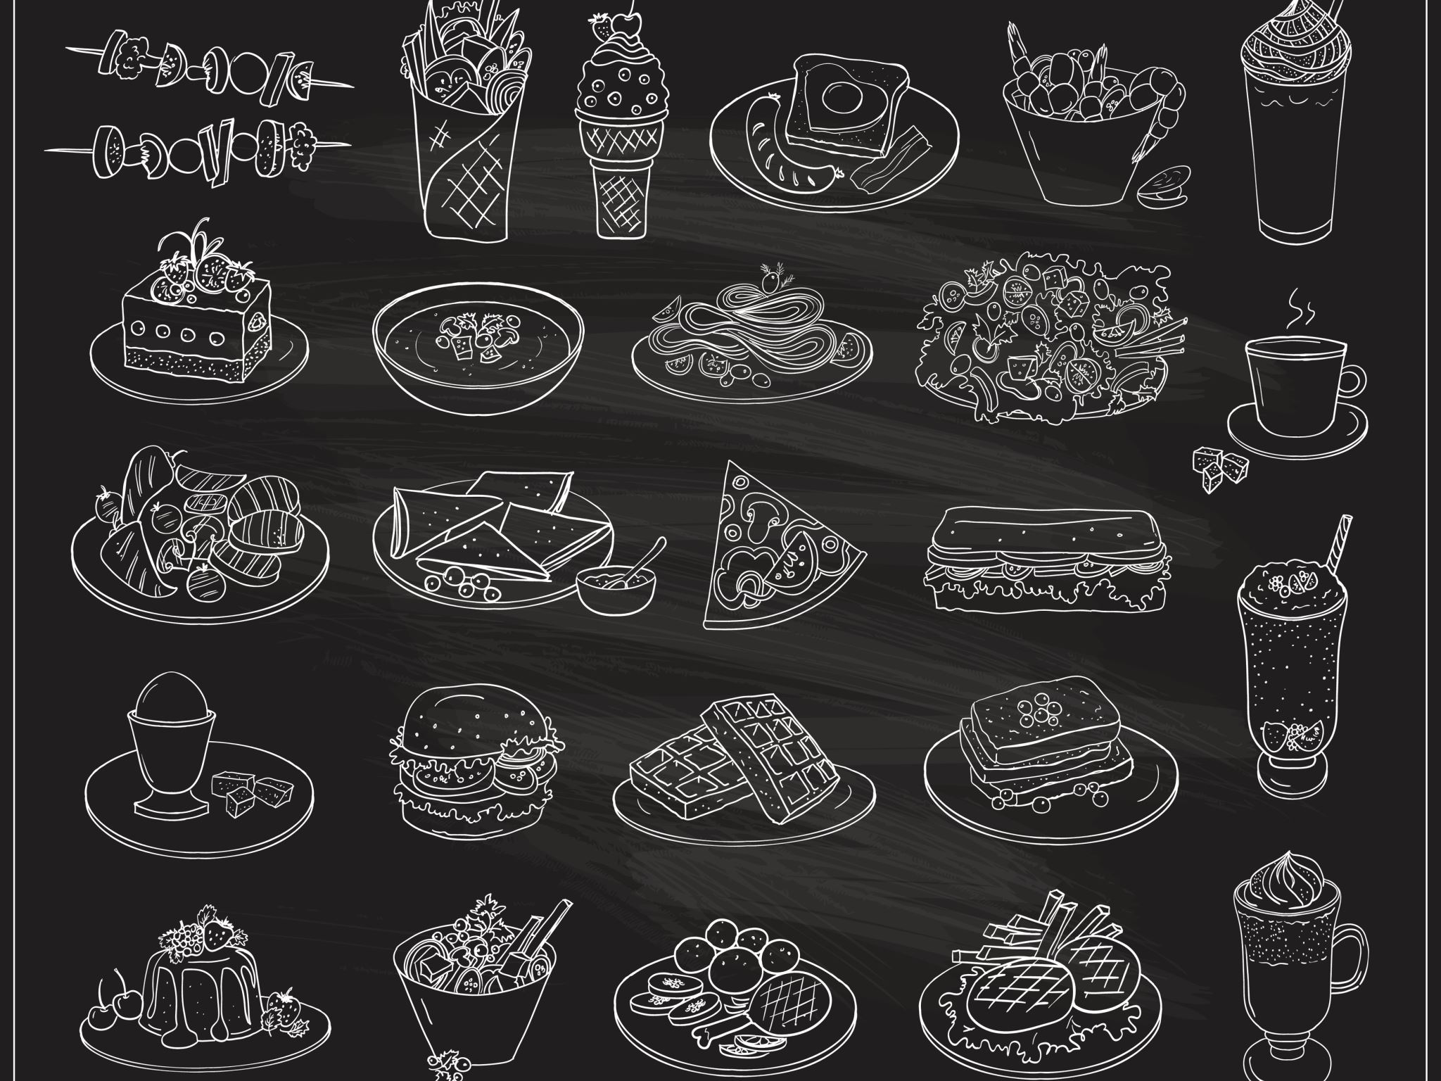


Restaurant Management System
Grup 7
Grup Üyeleri:
05210000196 Serdar Emin Polat
05210000197 Deniz Ceylan
05210000198 Ali Gökalp Karakuş
05210000253 Alp Kutay Köksal

Slide 2
1.1 - Architecture Overview
Architecture Pattern: Client-Server Web Application
Frontend: React + Tailwind CSS
Backend: Python (FastAPI)
Database: PostgreSQL
Main Components:
Frontend (User Interface)
Backend (Business Logic & API)
Database (Persistent Storage)

Slide 3
Frontend
React.js Application
Component-based architecture
State management using React Context API
Responsive design using Tailwind CSS

Slide 4
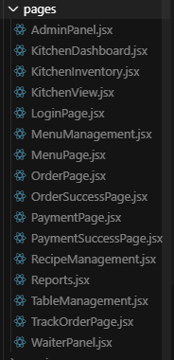
Frontend - Pages

Slide 5
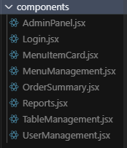
Frontend - Components

Slide 6
Backend
FastAPI RESTful API
SQLAlchemy ORM for database operations
JWT-based authentication system

Slide 7
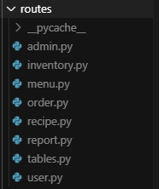
Backend - Routes

Slide 8
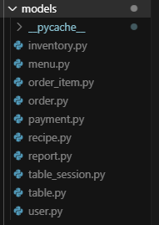
Backend - Models

Slide 9
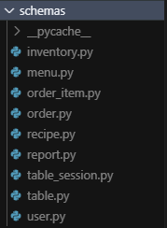
Backend - Schemas

Slide 10
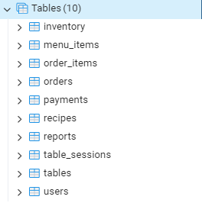
Database
PostgreSQL

Slide 11
Subsystems - 1
User Management
Authentication (Login)
Role-based access (Admin, Waiter, Kitchen)
User operations

Slide 12
Subsystem - 2
Order Management
Order creation and tracking
Order status updates
Order items management

Slide 13
Subsystem - 3
Menu Management
Menu items CRUD
Category management
Price management

Slide 14
Subsystem - 4
Table Management
Table status tracking
Session management
Occupancy monitoring

Slide 15
Subsystem - 5
Kitchen Management
Order preparation tracking
Inventory management
Recipe management

Slide 16
Subsystem - 6
Payment System
Payment processing
Payment status tracking
Order completion

Slide 17
Subsystem 7
Reporting System
Sales reports
Inventory reports

Slide 18
1.2 - System Architecture Diagram
Frontend
(Client)
Backend
(Server)
Database (PostgreSQL)

Slide 19
Detailed Component Interaction
Admin Panel
User Management
Menu Management
Table Management
Order Management
Payment System
Kitchen Management
Reports System
Recipe Management

Slide 20
1.3 – Architecture Implementation: From Theoretical to Practical
Client-Server Architecture Implementation
Theoretical Design:
Client <---> Server <---> Database
Practical Implementation:
React Frontend <--HTTP/HTTPS--> FastAPI Backend <--SQLAlchemy--> PostgreSQL

Slide 21
Frontend Implementation - 1
Theoretical Design:
Component-based architecture
State management
User interface
API communication

Slide 22
Frontend Implementation - 2
Practical Implementation:
React components (pages/, components/)
- LoginPage.jsx → User authentication interface
- MenuPage.jsx → Menu display and ordering
- OrderPage.jsx → Order creation
- TrackOrderPage.jsx → Order tracking
- AdminPanel.jsx → Administrative functions
- WaiterPanel.jsx → Table and order management
- KitchenView.jsx → Kitchen operations
React Context API for state management
Axios for API calls
Tailwind CSS for responsive design

Slide 23
Backend Implementation - 1
Theoretical Design:
RESTful API
Business logic
Data access
Authentication

Slide 24
Backend Implementation - 2
Practical Implementation:
FastAPI routes (routes/)
-/users → User management
-/tables → Table operations
-/orders → Order processing
-/menu → Menu management
-/admin → Administrative functions
-/recipe → Recipe management
-/report → Reporting system

Slide 25
Backend Implementation - 3
SQLAlchemy models (models/)
-User.py → User data structure
-Table.py → Table data structure
-Order.py → Order data structure
-Menu.py → Menu data structure
-Payment.py → Payment data structure
-Recipe.py → Recipe data structure
-Inventory.py → Inventory data structure
-Report.py → Report data structure

Slide 26
Database Implementation - 1
Theoretical Design:
Data persistence
Data relationships
Data validation

Slide 27
Database Implementation - 2
Practical Implementation:
- PostgreSQL tables
- users → User information
- tables → Table information
- table_sessions → Session tracking
- orders → Order information
- order_items → Order details
- menu_items → Menu information
- payments → Payment records
- recipes → Recipe information
- inventory → Stock information
- reports → Report data

Slide 28
Security Implementation - 1
Theoretical Design:
Authentication
Authorization
Data protection

Slide 29
Security Implementation - 2
Practical Implementation:
JWT token authentication
- Login endpoint → Token generation
- Protected routes → Token validation
Role-based access control
- Admin role → Full access
- Waiter role → Table and order management
- Kitchen role → Order preparation
API endpoint protection
- Route decorators → Access control
- Input validation → Data integrity

Slide 30
2.1 - UI Design Overview UI Design Principles
1. User Familiarity
Restaurant-oriented terminology
"Table" for dining tables
"Order" for food orders
"Menu" for food items
User-friendly interface elements
Menu cards
Order forms
Table views

Slide 31
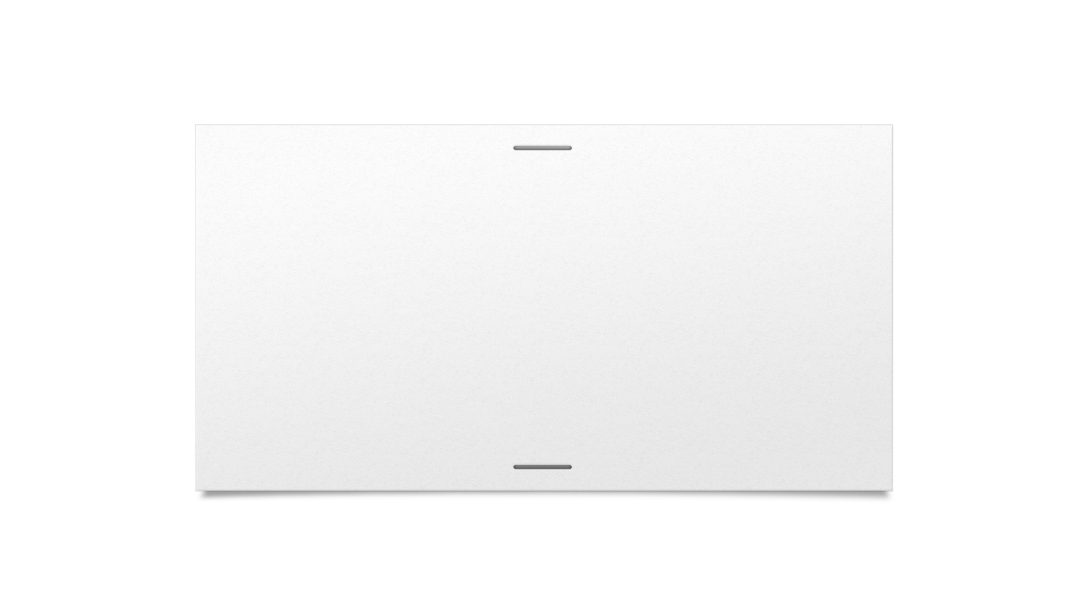


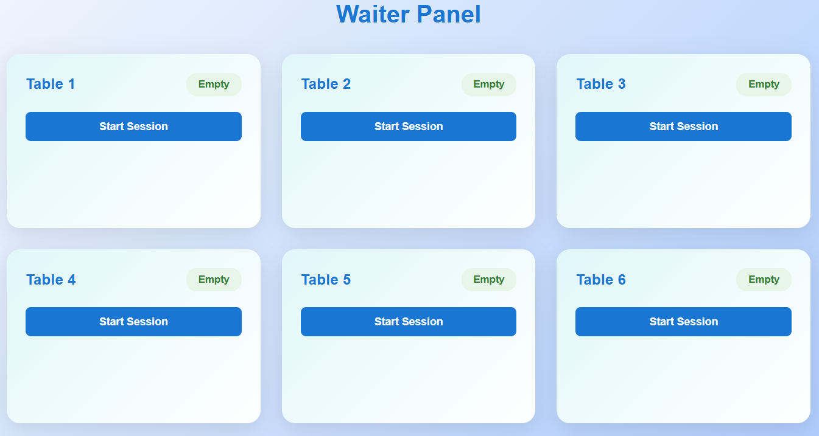
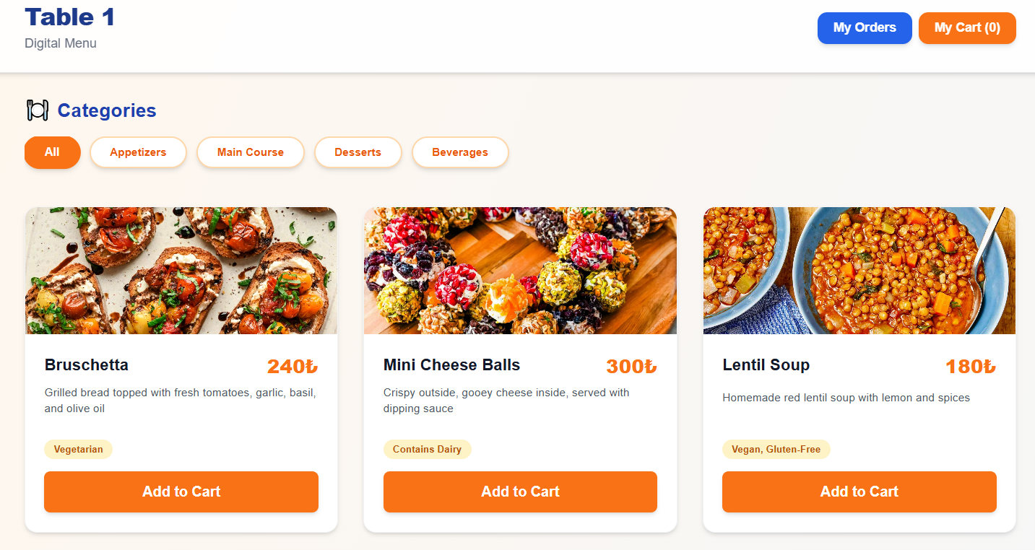
Examples from MenuPage and WaiterPanel

Slide 32
UI Design Principles - 2
2. Consistency
Consistent color scheme
Blue tones: #1976d2 (primary)
Orange tones: #ff9800 (secondary)
Consistent button styles
Primary buttons: Blue background
Secondary buttons: Orange background
Consistent card designs
Same card structure across all pages
Consistent shadows and border radius

Slide 33
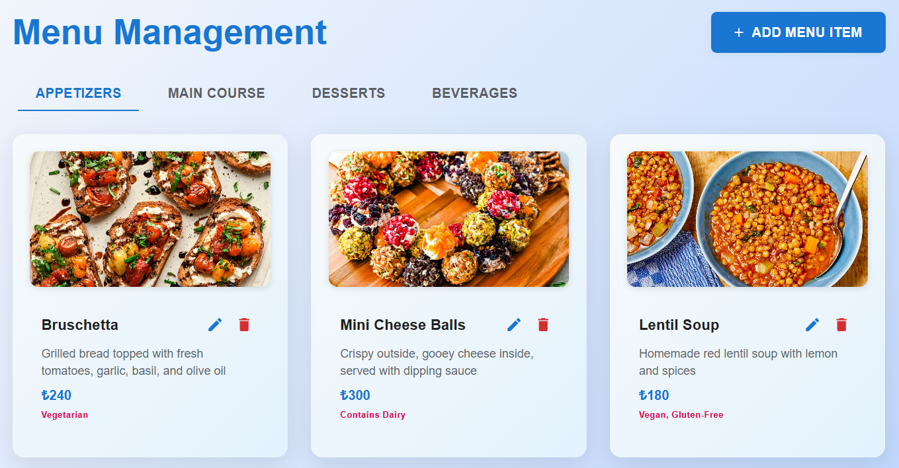
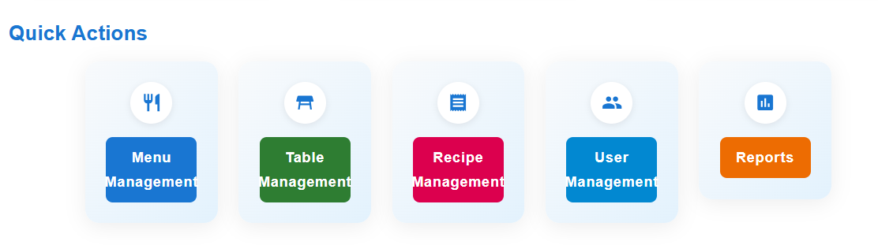
Examples from AdminPanel and MenuManagement

Slide 34
UI Design Principles - 3
3. Minimal Surprise
Predictable navigation
Left menu structure
Breadcrumb navigation
Consistent workflows
Order creation process
Payment process
Expected behaviors
Button clicks
Form submissions

Slide 35
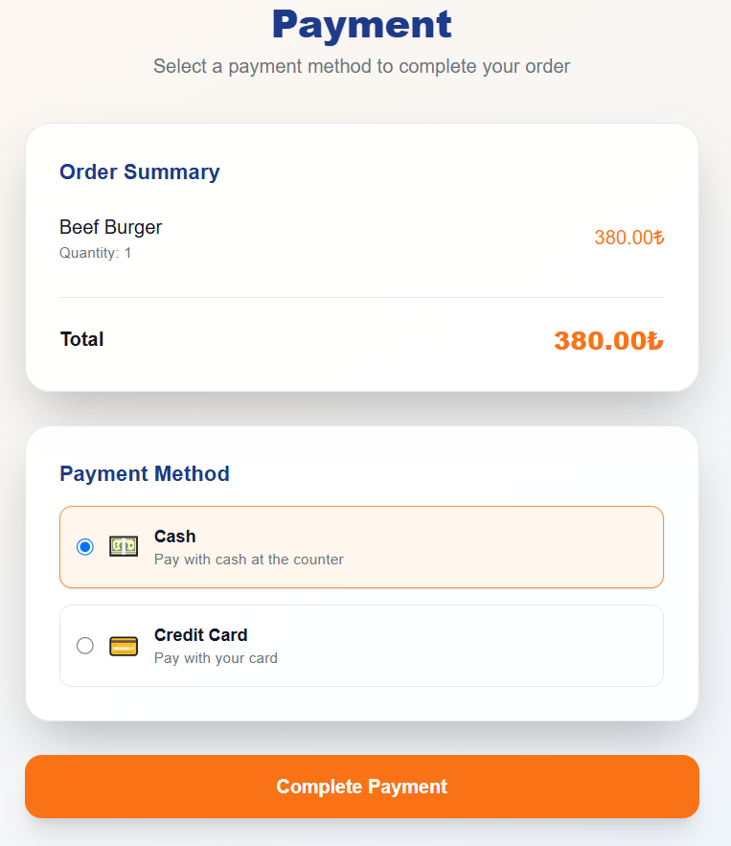
Example from PaymentPage

Slide 36
UI Design Principles - 4
4. Recoverability
Error recovery
Form validations
Error messages
Action confirmations
Order confirmation
Payment confirmation
Undo options
Navigation back button
Form reset

Slide 37
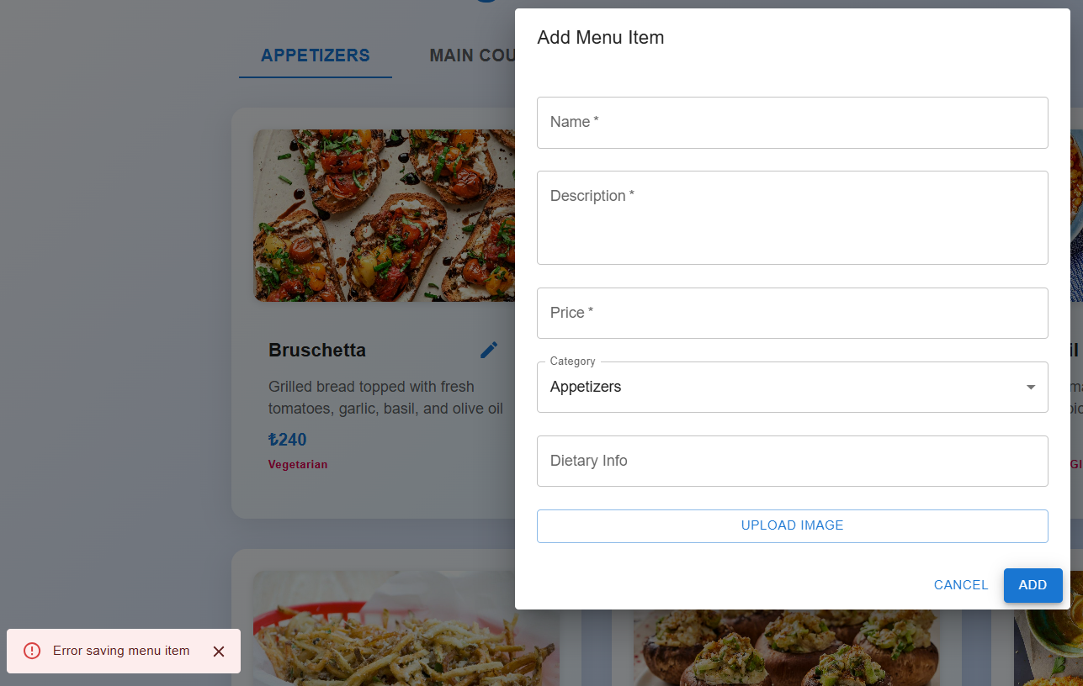
Example from Menu Management

Slide 38
UI Design Principles - 5
5. User Guidance
Help system
Tooltips
Descriptive labels
User feedback
Success/error messages
Loading indicators
Guidance
Step-by-step order process
Payment redirection

Slide 39
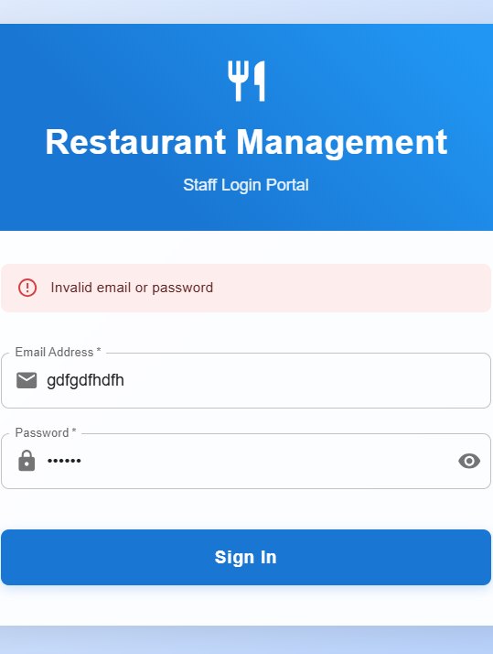
Example from LoginPage

Slide 40
UI Design Principles - 6
6. User Diversity
Responsive design
Mobile-friendly interface
Tablet-friendly interface
Accessibility
Sufficient contrast ratios
Readable font sizes
Different user roles
Admin panel
Waiter panel
Kitchen panel

Slide 41
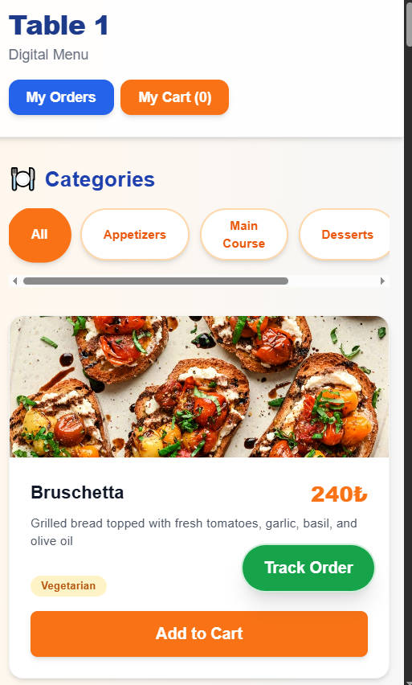
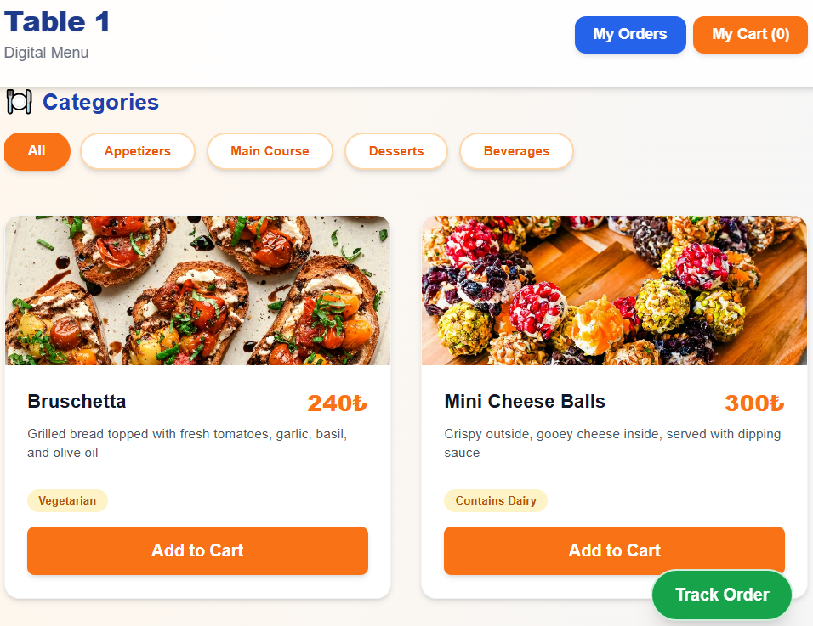
Example from MenuPage

Slide 42
2.2 Information Presentation
Presenting System Information
Principle: Information presentation is about how system information is shown to users. This can be direct (e.g., text, numbers) or transformed (e.g., charts, color codes, icons).
Implementation in Our System:
Orders, tables, and menu items are presented as cards and tables for clarity.
Statuses (e.g., order status, table occupancy) are shown with color-coded badges and icons.
Reports are presented in tabular form for easy comparison.
MenuPage.jsx: Menu items displayed as cards (direct presentation).
KitchenView.jsx: Orders displayed in a table with color-coded statuses (transformed presentation).
Reports.jsx: Sales and inventory data presented in tables.

Slide 43
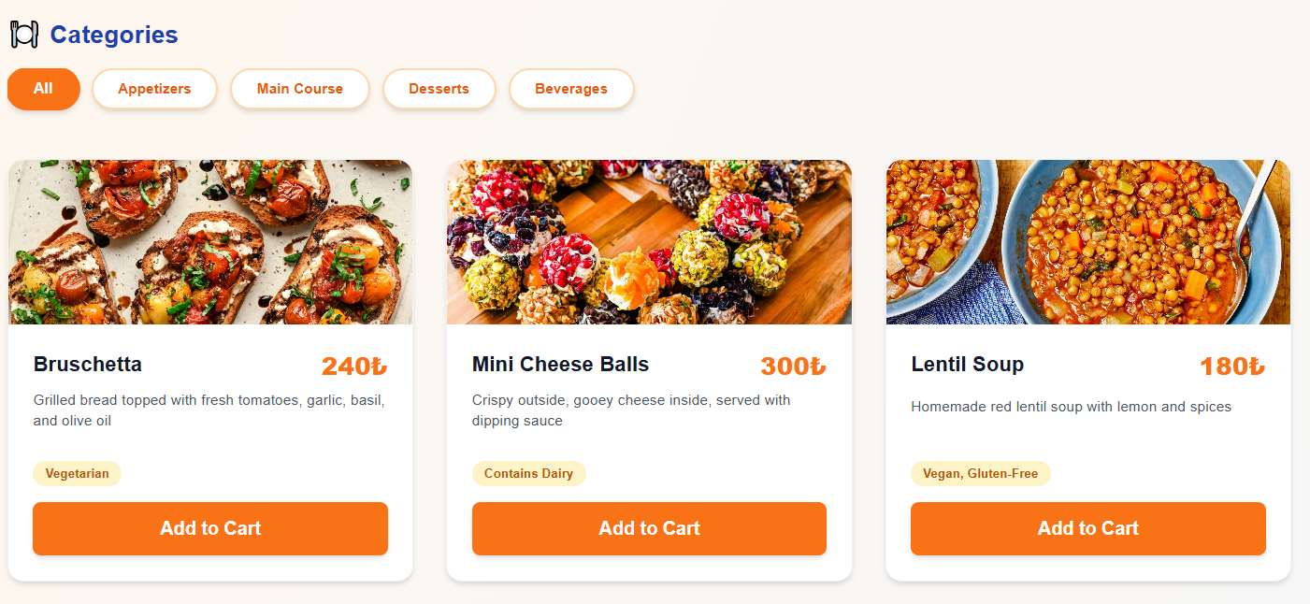
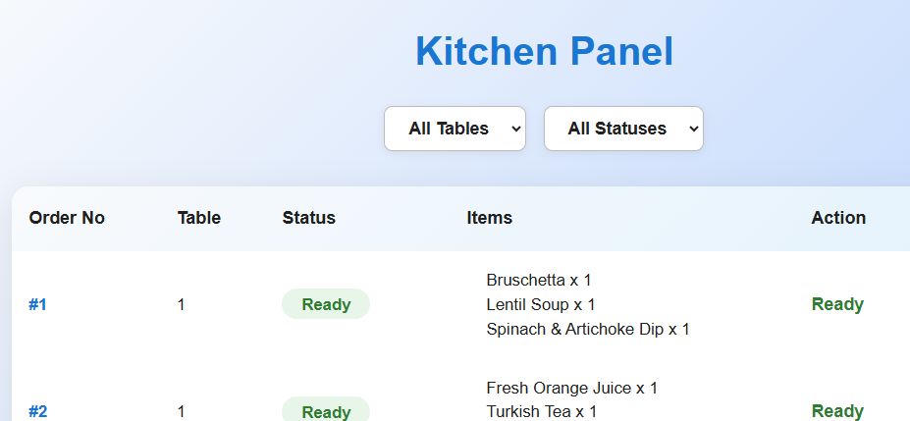
Examples from MenuPage and KitchenView

Slide 44
Information Presentation - 2
2. Static vs. Dynamic Information
Static information: Does not change during a session (e.g., menu item names, prices).
Dynamic information: Changes during a session and must be updated for the user (e.g., order status, table occupancy).
Implementation in Our System:
Static: Menu items, table numbers, user roles.
Dynamic: Order statuses, table occupancy, real-time updates in the kitchen and waiter panels.
MenuPage.jsx: Static menu information.
TrackOrderPage.jsx: Dynamic order status updates.
WaiterPanel.jsx: Dynamic table occupancy and session status.

Slide 45
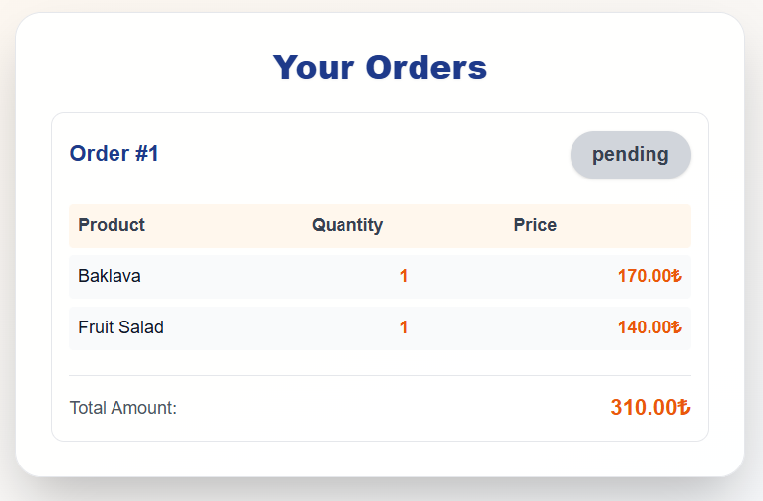
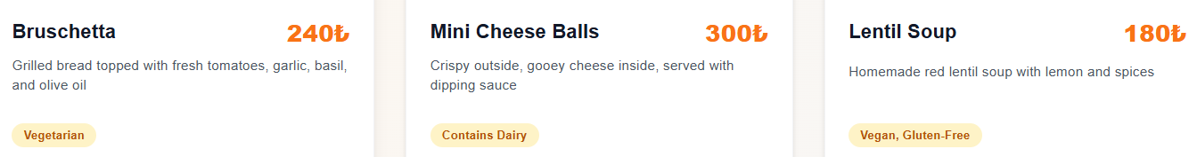
Examples from MenuPage and TrackOrderPage

Slide 46
Information Presentation - 3
3. Information Display Factors
Principle:Is the user interested in precise information or relationships?
How quickly does information change, and must it be indicated immediately?
Does the user need to act on changes?
Is the information textual or numeric?
Implementation in Our System:
Precise information: Order totals, item prices, table numbers.
Relationships: Which orders belong to which tables, which items are in which orders.
Immediate updates: Order status changes are shown in real-time.
User actions: Waiters and kitchen staff act on status changes.
KitchenView.jsx: Real-time order status and action buttons.
TrackOrderPage.jsx: Immediate feedback on order progress.
PaymentPage.jsx: Numeric and textual information about payments.

Slide 47
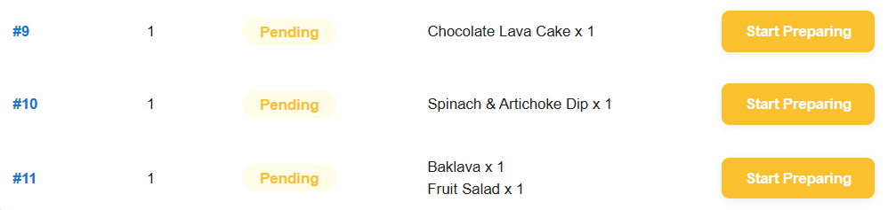
Examples from KitchenView and TrackOrderPage

Slide 48
Information Presentation - 4
4. Data Visualization
Principle:Visualization helps users understand trends, relationships, and exceptional events.
Implementation in Our System:
Use of tables and color codes to highlight important data (e.g., urgent orders, low inventory).
Visual grouping of related information (e.g., orders grouped by table).
Reports.jsx: Visualization of sales and inventory trends.
KitchenView.jsx: Highlighting of ready or urgent orders.

Slide 49
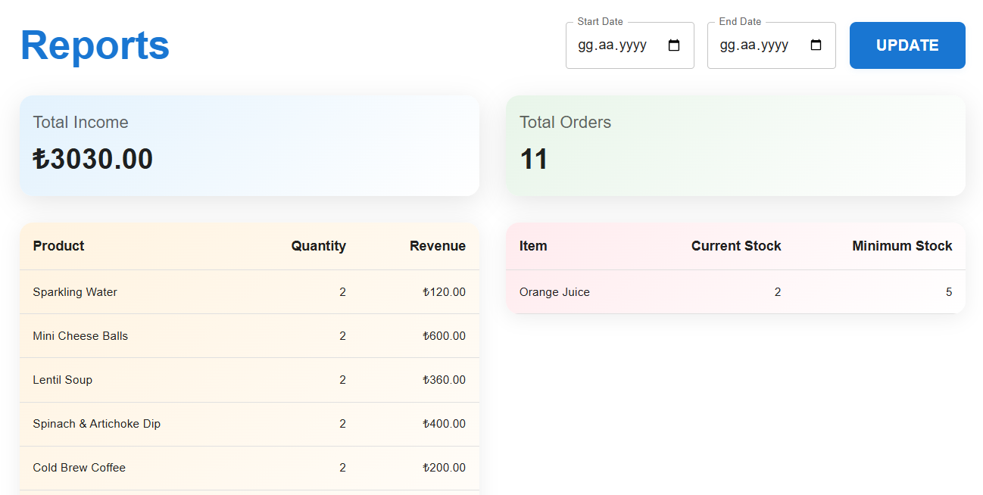
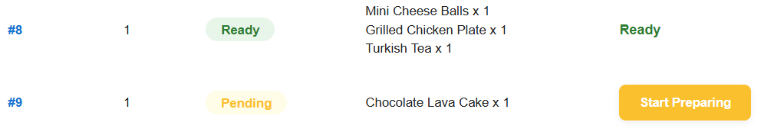
Examples from KitchenView and Reports

Slide 50
Information Presentation - 5
5. Colour Displays and Guidelines
Principle:Use color to add meaning, highlight exceptional events, and indicate status changes.
Avoid overuse of color; use it consistently and thoughtfully.
Implementation in Our System:
Blue and orange as primary colors for consistency.
Green for “ready” statuses, blue for “preparing,” red for errors or urgent items.
Minimal color palette to avoid confusion.
KitchenView.jsx: Color-coded order statuses.
TrackOrderPage.jsx: Status indicators with color.

Slide 51
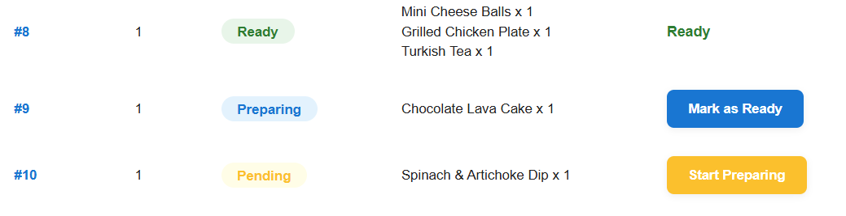
Examples from KitchenView

Slide 52
Information Presentation - 6
6. Error Messages
Principle:Error messages should be polite, concise, consistent, and constructive.
The design should consider the user’s background and experience.
Implementation in Our System:
Clear error messages for invalid form entries.
Confirmation dialogs for destructive actions (e.g., deleting a menu item).
Feedback for successful and failed actions.
LoginPage.jsx: Error messages for invalid login.
MenuManagement.jsx: Error and confirmation messages for menu operations.

Slide 53
Example from MenuManagement

Slide 54
2.3 Interaction Styles
1. Direct Manipulation
Definition: The user interacts directly with objects on the screen, such as clicking buttons, dragging items, or selecting cards.
Implementation in Our System: Users can click on menu items to add them to their order.
Waiters can click on tables to view or manage sessions.
Kitchen staff can click on orders to update their status.
Advantages: Fast and intuitive interaction, easy to learn for new users
Disadvantages: May be harder to implement for complex actions
Application Example:
MenuPage.jsx: Users click on food items to add them to their cart.
WaiterPanel.jsx: Waiters click on tables to manage sessions.

Slide 55
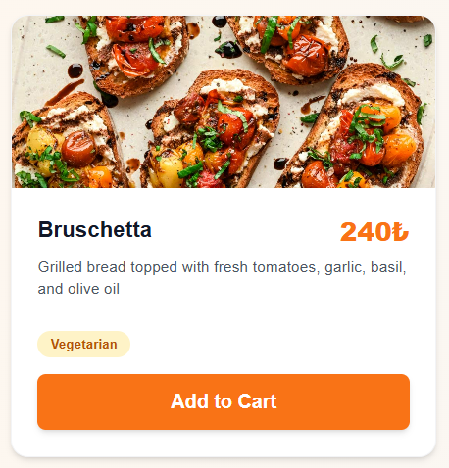
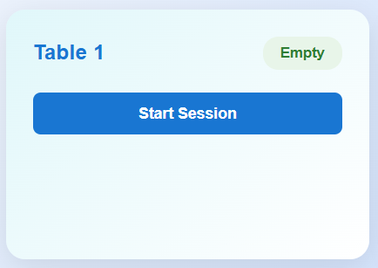
Examples from MenuPage and WaiterPanel

Slide 56
Interaction Styles - 2
2. Menu Selection
Definition:The user selects commands from a list of possibilities, usually through dropdowns or navigation menus.
Implementation in Our System:Navigation bar for switching between pages (e.g., Menu, Orders, Reports)
Dropdowns for filtering tables or orders by status
Advantages:Reduces user error, requires little typing
Disadvantages:Can be slow for experienced users if there are many options
Application Example:
AdminPanel.jsx: Menu selection for different management tasks
KitchenView.jsx: Status filter dropdown

Slide 57
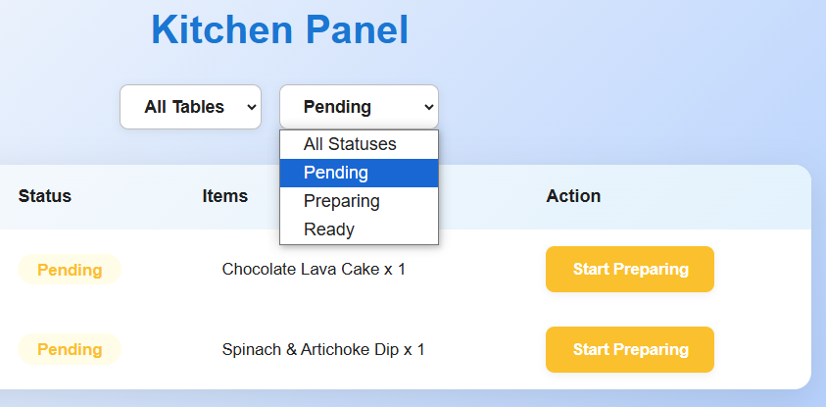
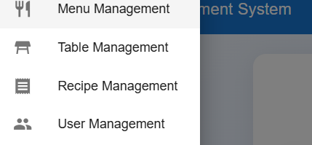
Examples from KitchenView and AdminPanel

Slide 58
Interaction Styles - 3
3. Form Fill-in
Definition:The user fills in the fields of a form to provide information.
Implementation in Our System:
Login form for authentication
Order creation form for specifying order details
Menu item creation/edit forms for admins
Advantages:Simple data entry, easy to learn and check
Disadvantages: Takes up screen space, can cause problems if form options do not match user needs
Application Example:
LoginPage.jsx: User authentication form
MenuManagement.jsx: Menu item add/edit form

Slide 59
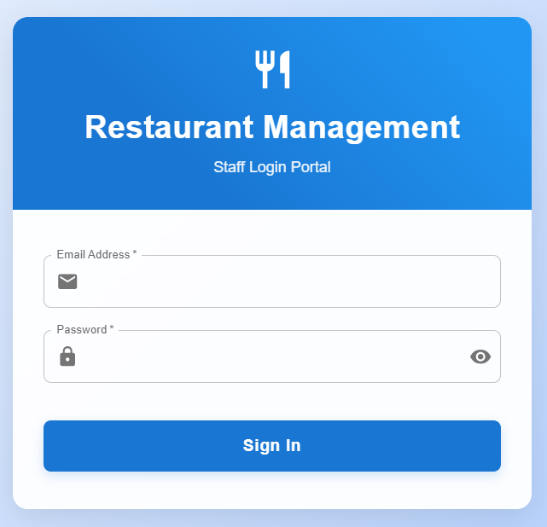
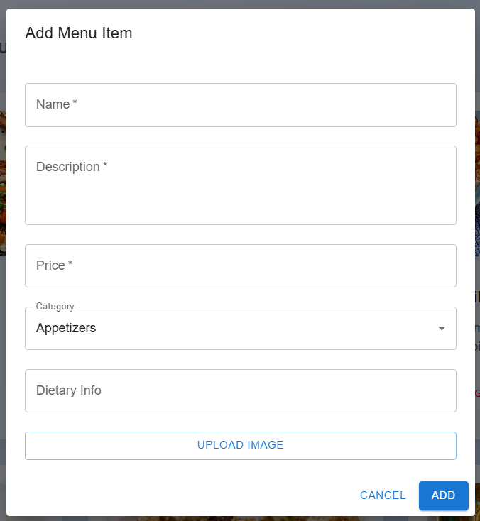
Examples from MenuManagement and LoginPage

Slide 60
3 - Testing Overview - 1
Title:Place Order & Payment Flow
Content:This test case covers a core use case of the restaurant ordering system:
A waiter starts a session for a table, a customer places an order, completes payment, and is redirected to the homepage, customer sees his/her orders.The scenario is directly related to the main user stories and requirements of the project.

Slide 61
Test Case Details
Test Case ID: TC01
Description:Waiter logs in and starts a session for Table 1 in the WaiterPanel.
Customer sits at Table 1, adds items to the cart, proceeds to payment, and completes the payment.
The system confirms the payment and redirects the customer to the homepage.
Elements Evaluated:
Table session management
Order creation and association with session
Payment processing
User redirection after successful payment

Slide 62
Test Inputs and Expected Outcomes
Inputs:
Table ID: 1
Waiter ID: 1
Cart: [Bruschetta x1, Sparkling Water x1]
Payment method: Credit card
Expected Outcomes:
Session is started for Table 1
Order is created and linked to the session
Payment is processed successfully
Payment success message is displayed
Customer is redirected to the homepage
TrackOrderPage has the order

Slide 63
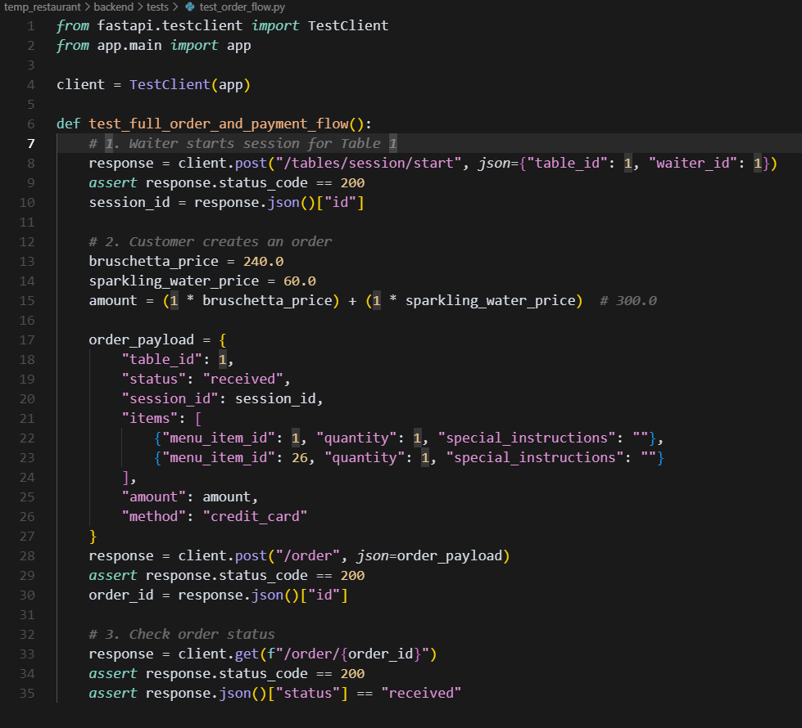
Test Code Snippet

Slide 64
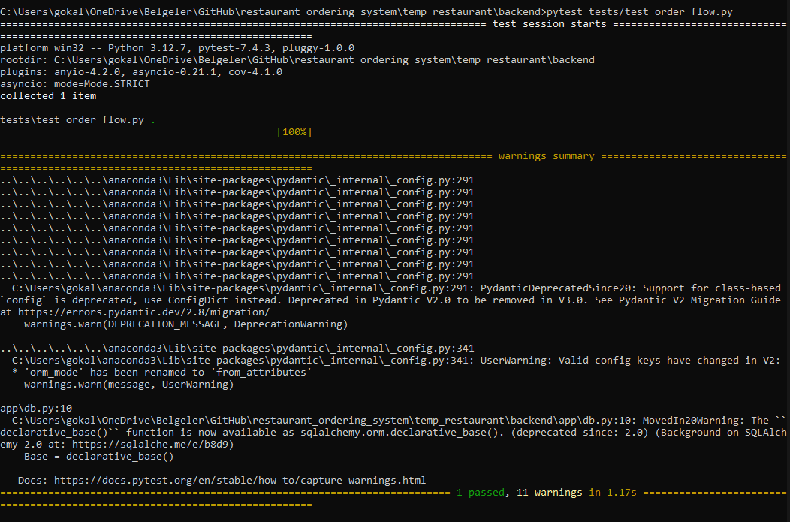
Test Result

Slide 65
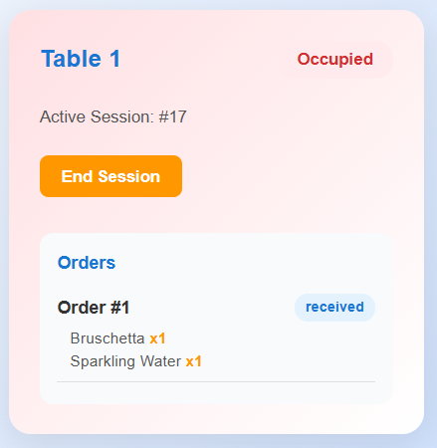
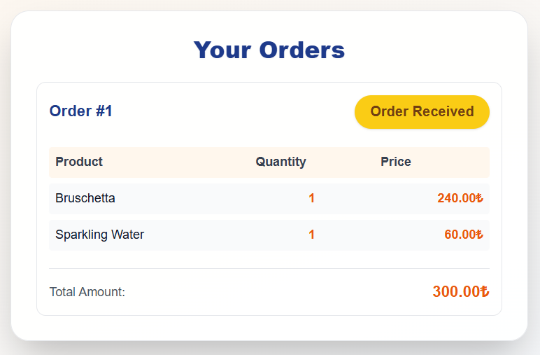
Result Screenshots from TrackOrderPage and WaiterPanel

Slide 66
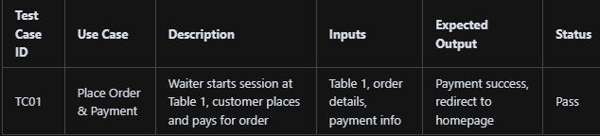
Test Case Summary

Slide 67
Testing Overview - 2
Title: Order Status Update by Kitchen Staff
Content: This test verifies that kitchen staff can update an order’s status from "pending" to "preparing" and then to "ready".
Ensures the system correctly reflects status changes for orders.

Slide 68
Test Case Deatils
Test Case ID: TC02
Description: Waiter starts a session for Table 3.
Customer places an order (status: pending).
Kitchen staff updates the order status to "preparing" and then to "ready".
Elements Evaluated:
Order status update endpoint
Status transitions and data integrity

Slide 69
Test Inputs & Expected Outcomes
Inputs: Table ID: 3
Waiter ID: 1
Order: Bruschetta x1
Status transitions: pending → preparing → ready
Expected Outcomes:
Order status is updated to "preparing" and then to "ready".
System returns correct status after each update.

Slide 70
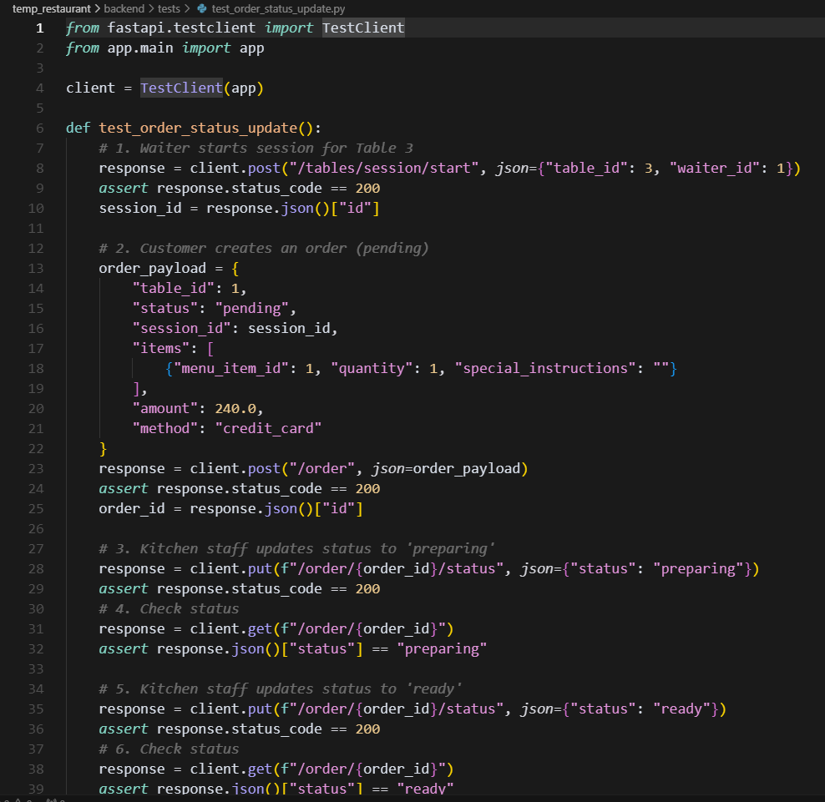
Test Code Snippet

Slide 71
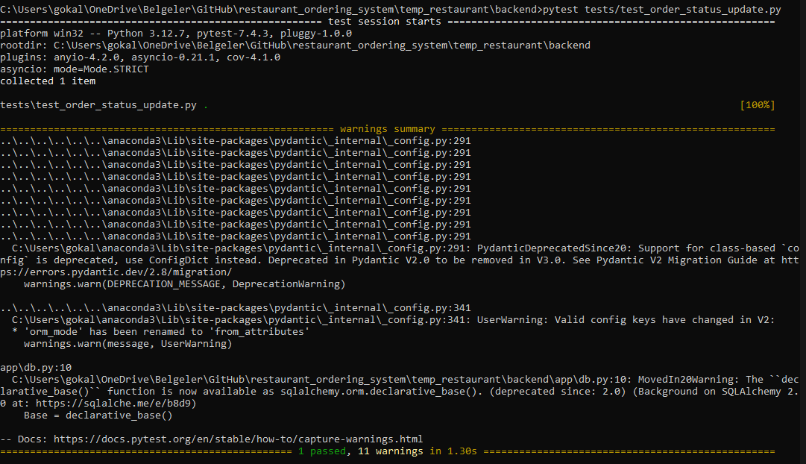
The Result

Slide 72
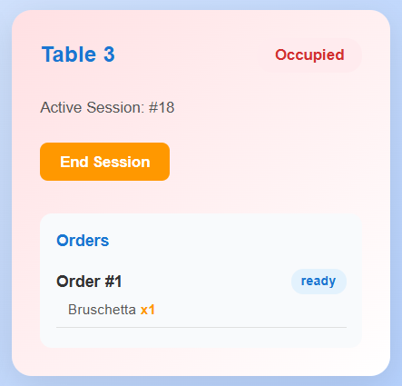
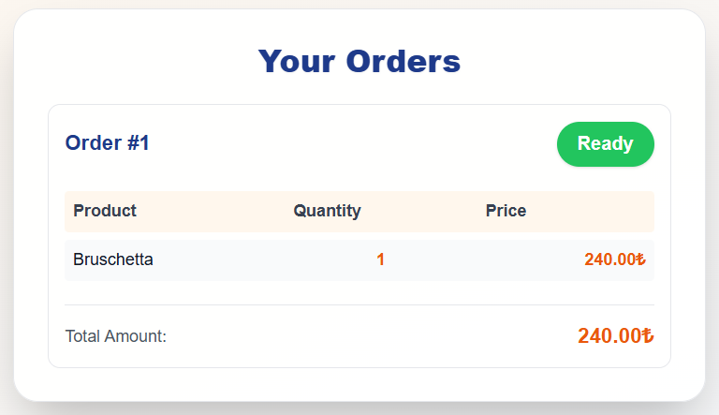
Result Screenshots from WaiterPanel, TrackOrderPage, KitchenView

Slide 73
Test Overview - 3
Title: Menu Item Creation by Admin
Content:This test verifies that an admin can create a new menu item.
Ensures the new item appears in the menu list.

Slide 74
Test Case Details
Test Case ID: TC03
Description: Admin creates a new menu item ("Test Pizza").
System returns the new item’s ID.
Menu list includes the new item.
Elements Evaluated:
Menu item creation endpoint
Menu list retrieval

Slide 75
Test Inputs & Expected Outcomes
Inputs: Name: Test Pizza
Description: A test pizza for unit testing.
Price: 420.0
Category: Main Course
Image URL: /uploads/vegan_pizza.jpg
Dietary Info: Vegan
Expected Outcomes:
New menu item is created and assigned an ID.
Menu list contains the new item with correct details.

Slide 76
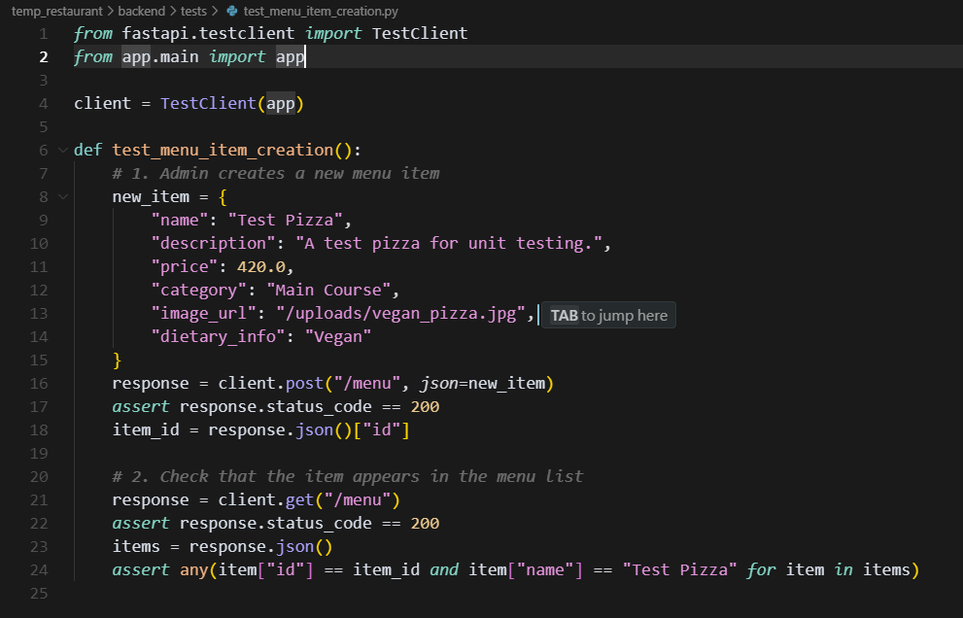
Test Code Snippet

Slide 77
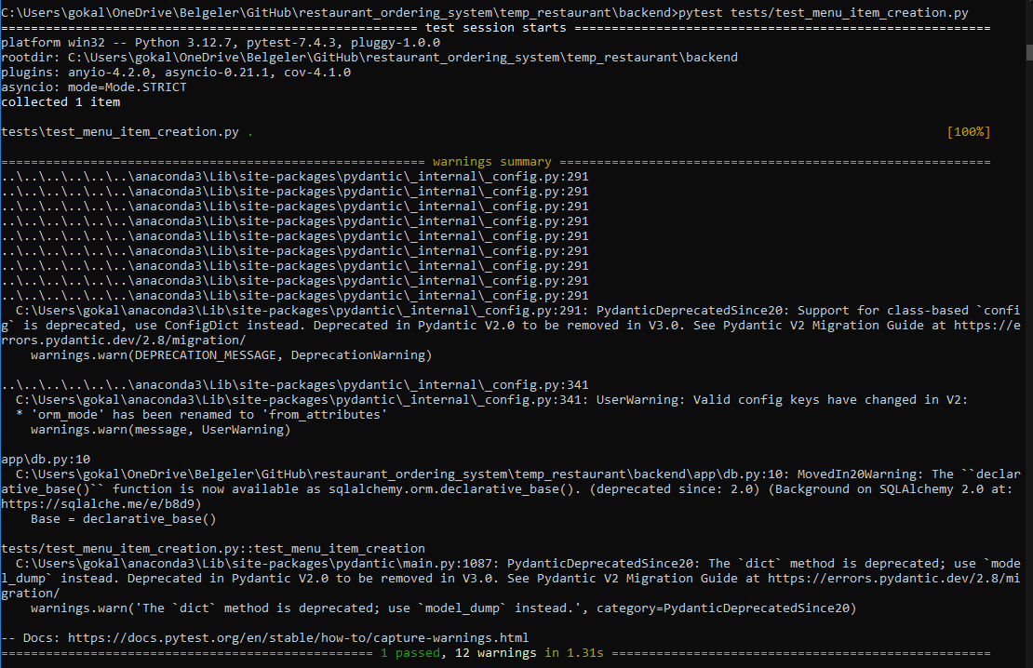
The Result

Slide 78
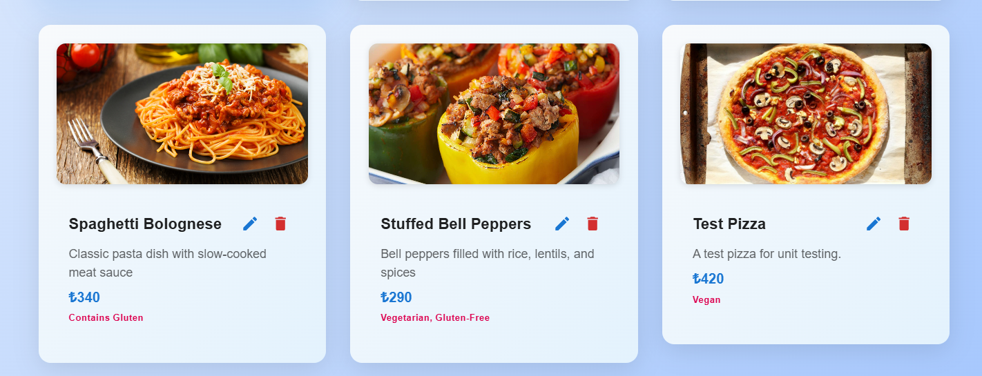
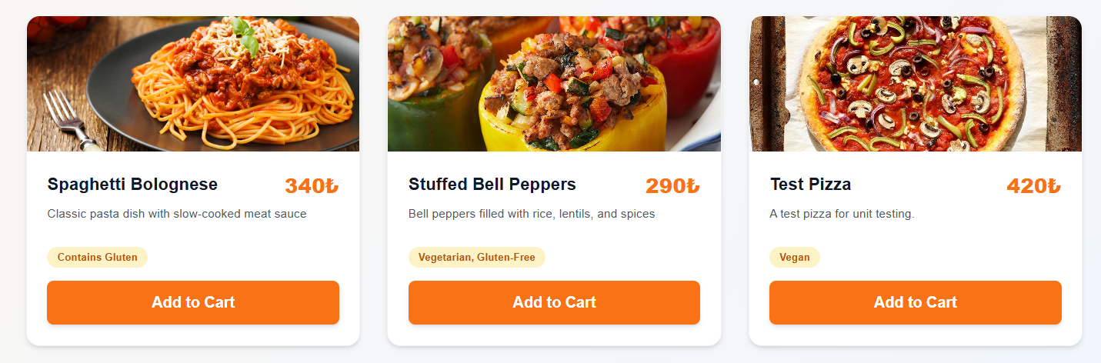
Result Screenshots from MenuManagement and MenuPage

Slide 79
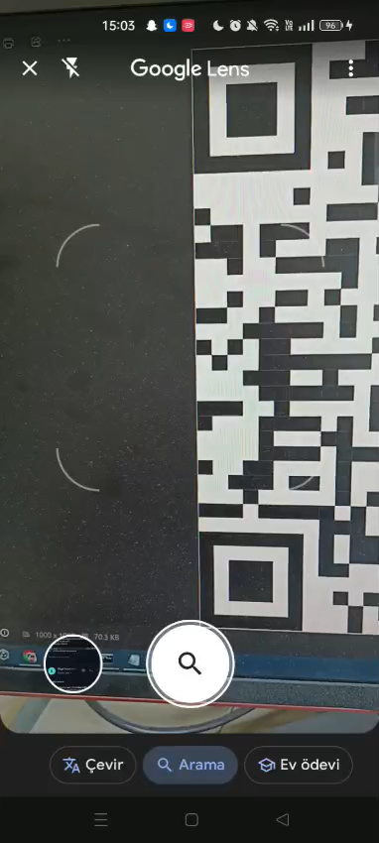
QR Code Access Example

Slide 80
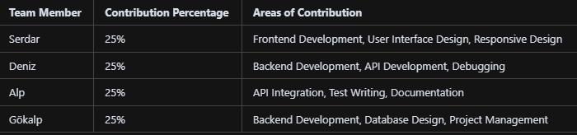
Team Work

Slide 81
Conclusion
The core functionalities of the Restaurant Ordering System have been thoroughly tested using automated backend API tests.
Each critical use case—such as order processing, menu management, and table session handling—was validated to ensure system reliability and correctness.
Automated testing increases confidence in the system, reduces the risk of bugs, and supports future development and maintenance.
The successful test results demonstrate that the system meets its main requirements and is ready for real-world use.
Thank you for your attention!

